Slide 1

HTTP and REST Services
HTTP, Request Headers, RESTful Web Services
SoftUni Team
Technical Trainers
Software University
https://softuni.bg

Slide 2
Table of Contents
HTTP Overview
HTTP Developer Tools
REST and RESTful Services
Accessing the GitHub API
Popular BaaS Providers

Slide 3
Have a Question?
sli.do #js-advanced

Slide 4

HTTP Overview
Hypertext Transfer Protocol

Slide 5



HTTP Basics
HTTP (Hyper Text Transfer Protocol)
Text-based client-server protocol for the Internet
For transferring Web resources (HTML files, images, styles, etc.)
Request-response based
HTTP request
HTTP response
Web Client
Web Server

Slide 6






HTTP Request Methods
HTTP defines methods to indicate the desired action to be performed on the identified resource
Method | Description
GET | Retrieve / load a resource
POST | Create / store a resource
PUT | Update a resource
DELETE | Delete (remove) a resource
PATCH | Update resource partially
HEAD | Retrieve the resource's headers
OPTIONS | Returns the HTTP methods that the server supports for the specified URL

Slide 7
HTTP GET Request – Example
GET /users/testnakov/repos HTTP/1.1
Host: api.github.com
Accept: */*
Accept-Language: en
Accept-Encoding: gzip, deflate
User-Agent: Mozilla/5.0 (Windows NT 10.0; WOW64) AppleWebKit/537.36 (KHTML, like Gecko) Chrome/54.0.2840.71 Safari/537.36
Connection: Keep-Alive
Cache-Control: no-cache
<CRLF>
HTTP request line
HTTP headers
The request body is empty

Slide 8
HTTP POST Request – Example
POST /repos/testnakov/test-nakov-repo/issues HTTP/1.1
Host: api.github.com
Accept: */*
Accept-Language: en
Accept-Encoding: gzip, deflate
User-Agent: Mozilla/4.0 (compatible;MSIE 6.0; Windows NT 5.0)
Connection: Keep-Alive
Cache-Control: no-cache
<CRLF>
{"title":"Found a bug",
"body":"I'm having a problem with this.",
"labels":["bug","minor"]}
<CRLF>
HTTP request line
HTTP headers
The request body holds the submitted data

Slide 9
HTTP Response – Example
HTTP response status line
HTTP/1.1 200 OK
Date: Fri, 11 Nov 2016 16:09:18 GMT+2
Server: Apache/2.2.14 (Linux)
Accept-Ranges: bytes
Content-Length: 84
Content-Type: text/html
<CRLF>
<html>
<head><title>Test</title></head>
<body>Test HTML page.</body>
</html>
HTTP response headers
HTTP response body

Slide 10
HTTP Response Status Codes
Status Code | Action | Description
200 | OK | Successfully retrieved resource
201 | Created | A new resource was created
204 | No Content | Request has nothing to return
301 / 302 | Moved | Moved to another location (redirect)
400 | Bad Request | Invalid request / syntax error
401 / 403 | Unauthorized | Authentication failed / Access denied
404 | Not Found | Invalid resource
409 | Conflict | Conflict was detected, e.g. duplicated email
500 / 503 | Server Error | Internal server error / Service unavailable

Slide 11
Content-Type and Disposition
The Content-Type / Content-Disposition headers specify how the HTTP request / response body should be processed
JSON-encoded data
UTF-8 encoded HTML page. Will be shown in the browser
Content-Type: application/json
Content-Type: text/html; charset=utf-8
Content-Type: application/pdf
Content-Disposition: attachment; filename="Financial-Report-April-2016.pdf"
This will download a PDF file named Financial-Report-April-2016.pdf

Slide 12

HTTP Developer Tools
Browser Dev Tools, Postman

Slide 13
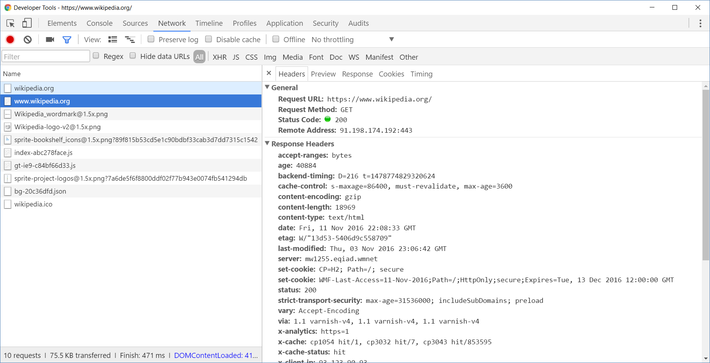
Browser Developer Tools

Slide 14
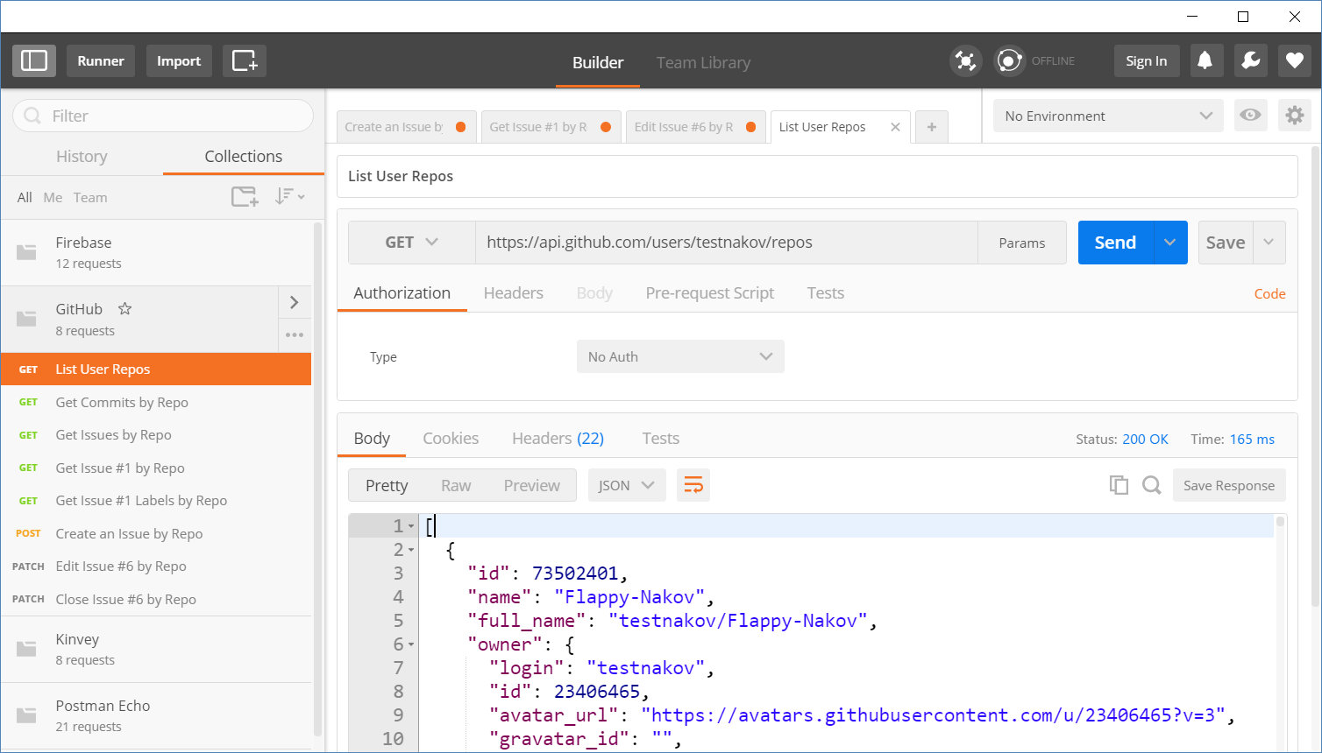
Postman
Read more about Postman REST Client

Slide 15
REST and RESTful Services
{REST}

Slide 16
REST and RESTful Services
Representational State Transfer (REST)
Architecture for client-server communication over HTTP
Resources have URI (address)
Can be created/retrieved/ modified/deleted/etc.
RESTful API/RESTful Service
Provides access to server-side resources via HTTP and REST
REST Web Service
URI
Resource
Representation 1
Representation 2
Representation 3
Representation 4
GET
PUT
POST
DELETE
Uniform Method

Slide 17

REST Architectural Constraints
REST defines 6 architectural constraints which make any web service a true RESTful API
Client-server architecture
Statelessness
Cacheable
Layered system
Code on demand (optional)
Uniform interface
Read more about REST Architectural Constraints

Slide 18
REST and RESTful Services – Example
Create a new post
Get all posts / specific post
Delete existing post
Replace / modify existing post
POST
http://some-service.org/api/posts
GET
http://some-service.org/api/posts
GET
http://some-service.org/api/posts/17
DELETE
http://some-service.org/api/posts/17
PUT/PATCH
http://some-service.org/api/posts/17

Slide 19

Accessing GitHub Through HTTP
GitHub REST API

Slide 20
GitHub API
List user's all public repositories:
Get all commits from a public repository:
Get all issues/issue #1 from a public repository
GET
https://api.github.com/users/testnakov/repos
GET
https://api.github.com/repos/testnakov/softuniada-2016/commits
GET
/repos/testnakov/test-nakov-repo/issues
GET
/repos/testnakov/test-nakov-repo/issues/1

Slide 21

Github: Labels Issue
Get the first issue from the "test-nakov-repo" repository
Send a GET request to:
https://api.github.com/repos/testnakov/test-nakov-repo/ issues/:id
Where :id is the current issue

Slide 22
GitHub API (2)
Get all labels for certain issue from a public repository:
Create a new issue to certain repository (with authentication)
GET
https://api.github.com/repos/testnakov/test-nakov-repo/issues/1/labels
POST
https://api.github.com/repos/testnakov/test-nakov-repo/issues
Headers
Authorization: Basic base64(user:pass)
Body
{"title":"Found a bug",
"body": "I'm having a problem with this."}

Slide 23
Github: Create Issue
Create an issue when you send a "POST" request
Use your Github account credentials to submit the issue

Slide 24



Popular Providers
Back-end as a Service

Slide 25
Back-end as a Service
Web applications require a back-end to store information
User profiles, settings, content, etc.
Creating a back-end can be very time consuming
Ready to use back-end services are available (free trial):
Firebase
Backendless
Back4App
And more

Slide 26

Live Demonstration
Firebase Application

Slide 27
Live Demonstration
Backendless Application

Slide 28
Live Demonstration
Back4App Application

Slide 29
Summary
…
…
…
HTTP is text-based request-response protocol
REST uses GET, POST, PUT, PATCH, DELETE
RESTful services address resources by URL
Provide CRUD operations over HTTP
Many BaaS providers have free trials

Slide 30
Questions?
Notes:
30

Slide 31














SoftUni Diamond Partners

Slide 32

Educational Partners

Slide 33
Trainings @ Software University (SoftUni)
Software University – High-Quality Education, Profession and Job for Software Developers
softuni.bg, softuni.org
Software University Foundation
softuni.foundation
Software University @ Facebook
facebook.com/SoftwareUniversity
Software University Forums
forum.softuni.bg
Notes:
33

Slide 34

License
This course (slides, examples, demos, exercises, homework, documents, videos and other assets) is copyrighted content
Unauthorized copy, reproduction or use is illegal
© SoftUni – https://softuni.org
© Software University – https://softuni.bg
Notes:
34

